Slide 1

ABC Inc.
Market Analysis
Drug launch in Type-2 Diabetes Market.

Slide 2
Problem Statement
Client Name: ABC Inc.
Description: Client is preparing to launch its first drug in the Type-II Diabetes Market. The client is launching their drug in GLP1 class and considers classes GLP1 and SGLT as their key competition.
Questions:
Branded vs Generic Market Scenario – Slide 4
How the market share of various Product classes and Product families has evolved in the
past two years? – Slide 5
Identify products which have shown growth , decline or are stable with respect to their
sales. – Slide 6
Assess the performance of specially GLP1 class as well products within it – Slide 7
Annual Cost of therapy of Drugs within GLP1 and SGLT class – Slide 8

Slide 3
Given data contains:
Branded Drug Classes:
DPP4
Glitazone
GLP1
Insulin, Fast Acting
Insulin, Intermedicate Acting
Insulin, Long Acting
Metformin/SU
Others
SGLT
KPIs: TRx Count, NRx Count, TRx MBS Dollars
Branded or Generic drug
Time Period: Jan 2015 to Dec 2016
9 Classes
53 Product Families
106 Products
Understanding:
NRx: New Prescriptions
TRx: Total Prescriptions
TRx MBS Dollars: Total Sales
Generic Drug Classes:
Metformin/SU
Glitazone
Others

Slide 4
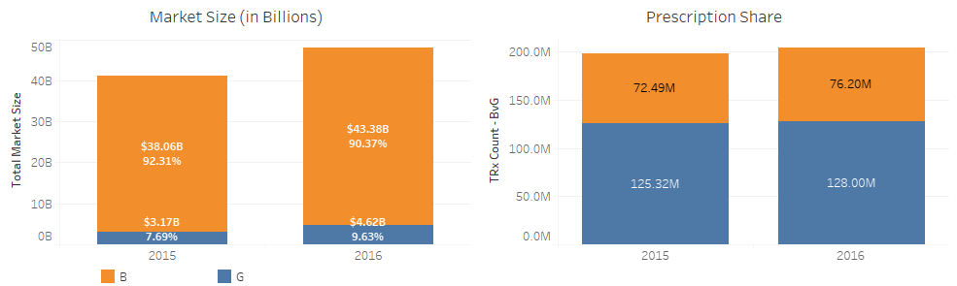
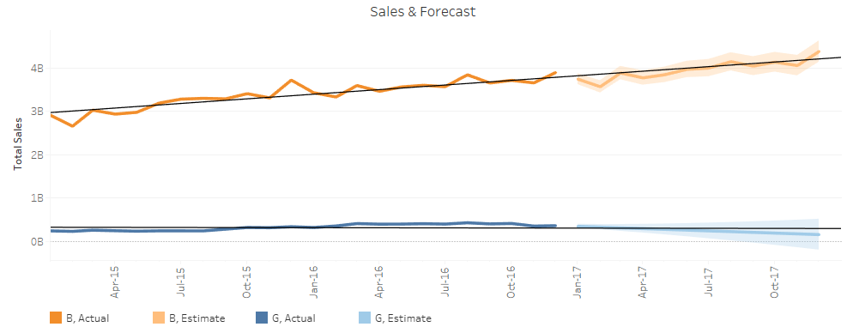
Branded v Generic Market Analysis
Annual Market Sales
2015: $ 41.3 Billion
2016: $ 48 B Billion
Sales Forecast
Branded: $ 47.62 Billions
Generic: $ 2.99 Billions
Sales Growth
Prescription Share (2016)
Avg. Price per prescription
Growth: 16%
Branded: 14%
Generic: 46%
Branded: 76.2 Million
Generic: 128 Million
Total: $ 50.61 Billions
Branded: $ 547.73
Generic: $ 30.75

Slide 5
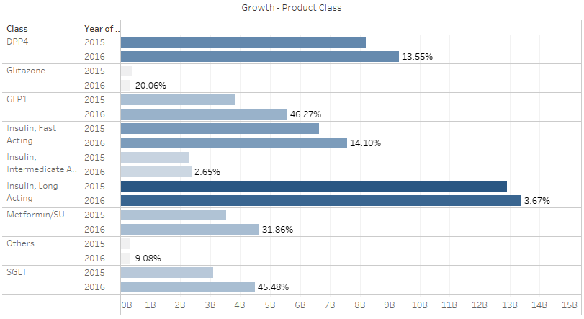
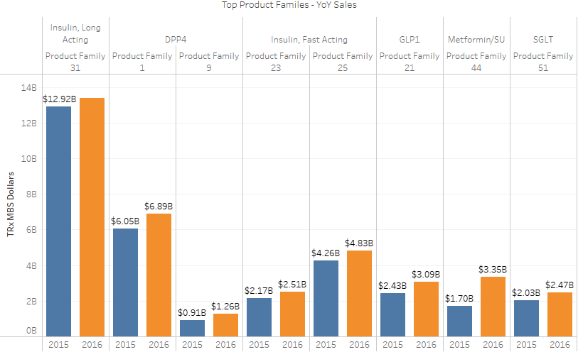
Growth – Drug Class
GLP1 and SGLT are the two classes with the highest growth; 46.27% and 45.48% respectively – which results in a very high competition in all products within these classes.
Long Acting Insulin has the highest market share among all the classes, followed by DPP4.

Slide 6
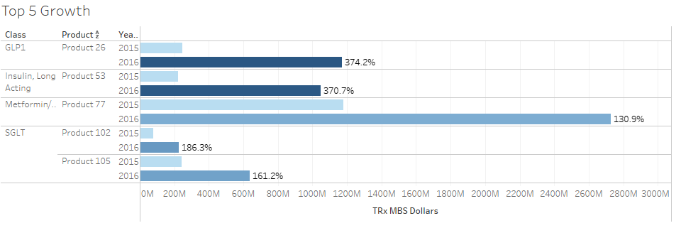
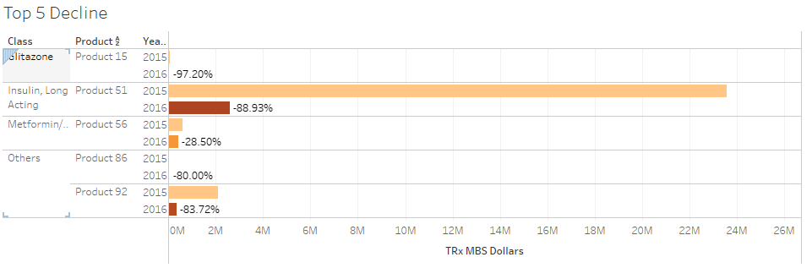
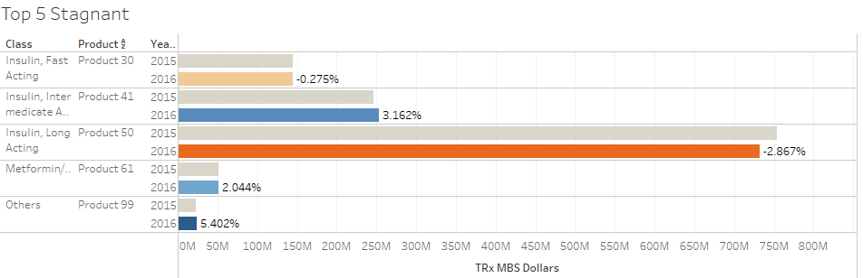
Product Analysis - Growing, Declining and Stable
Top 5 Growing products:
Product 26, 53, 102, 105, 77
Three of the top 5 from SGLT or GLP1
Top 5 Declining products:
Product 92, 15, 51, 56, 86
Top 5 Stagnant products:
Product 30, 61,50, 41, 99
SGLT and GLP1 class has three of the top 5 most growing products and none from declining or stable.

Slide 7
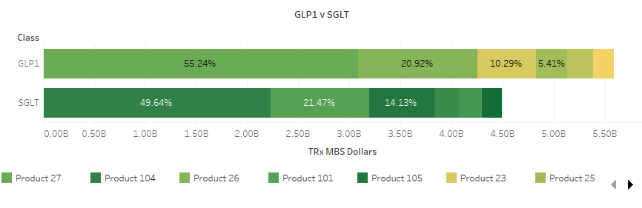

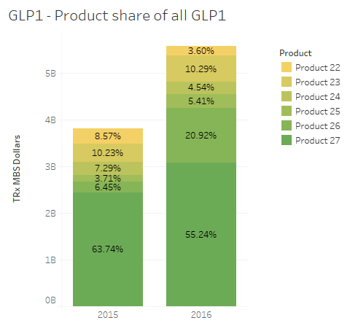
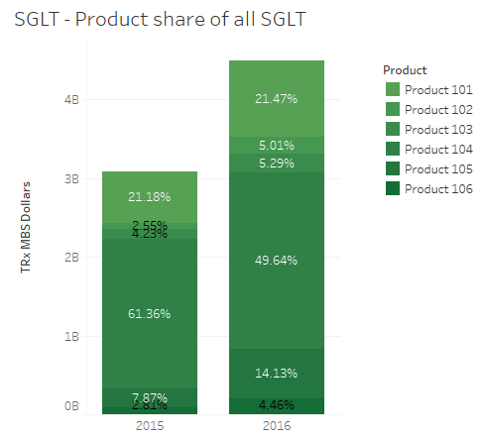
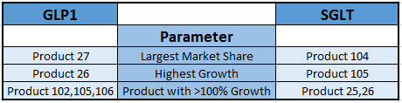
Competition Analysis – GLP1 vs SGLT

Slide 8
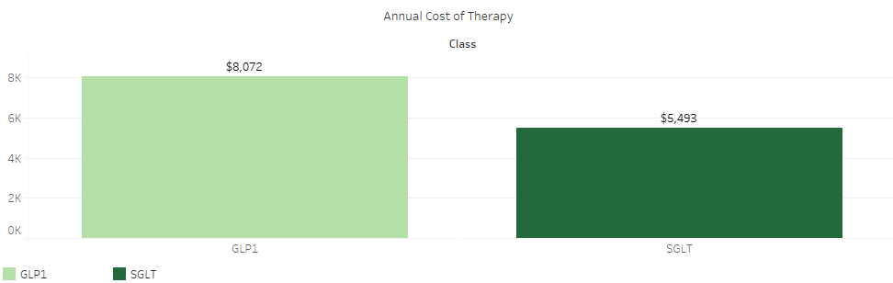
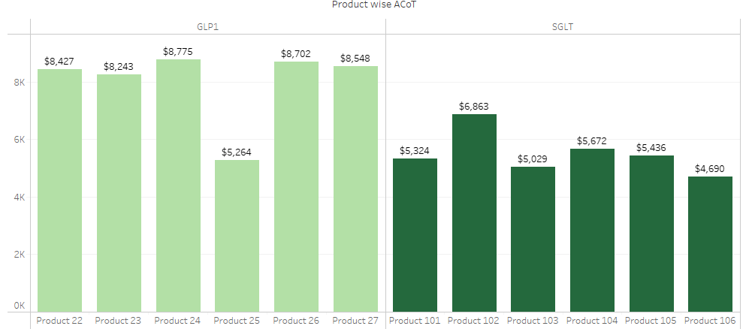
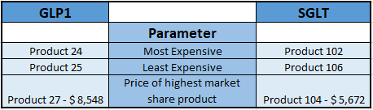
Annual Cost of Therapy – GLP1 vs SGLT
Annual Cost of Therapy:
GLP1: $ 8,072
SGLT: $ 5,493

Slide 9
Thank You

